Slide 1
ETHICS
A Framework for Making Ethical Decisions
https://www.brown.edu/academics/science-and-technology-studies/framework-making-ethical-decisions#:~:text=Three%20Frameworks,Framework%3B%20and%20the%20Virtue%20Framework.

Slide 2
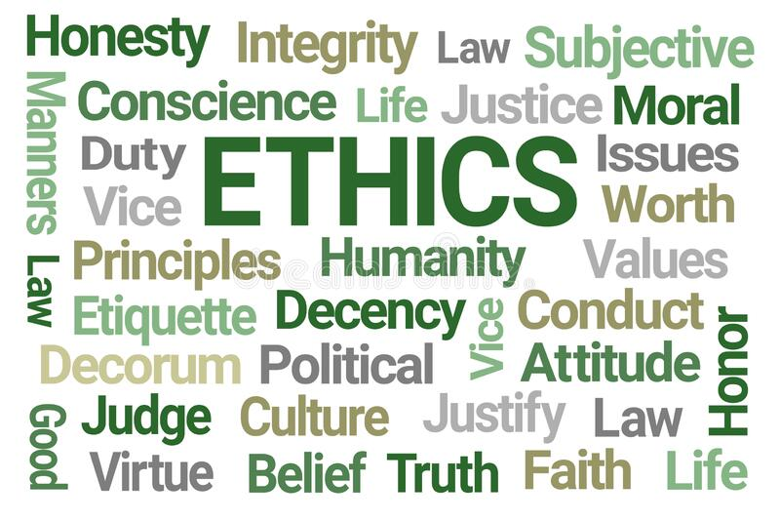

Slide 3
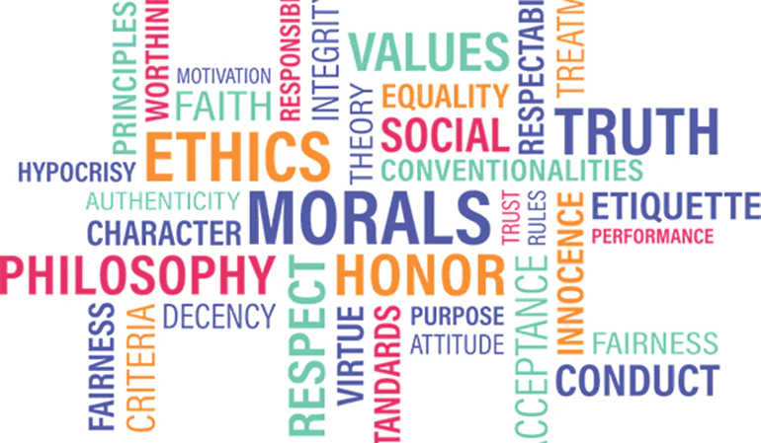

Slide 4
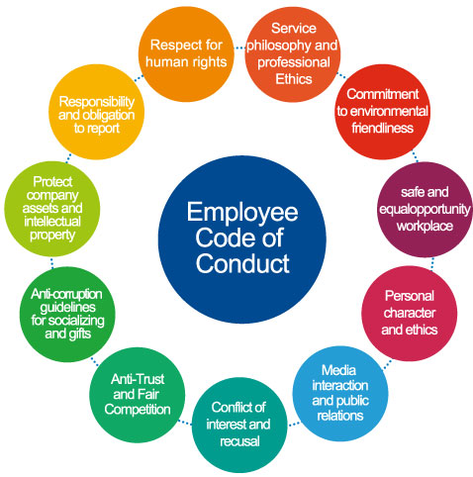
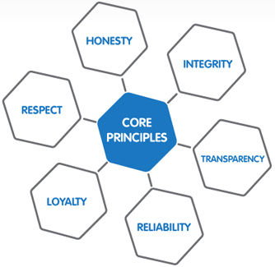

Slide 5
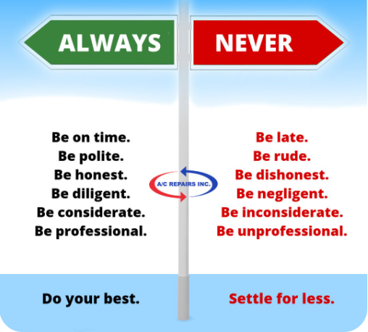
A Code of Conduct is a guide to expected Ethical Behaviour

Slide 6
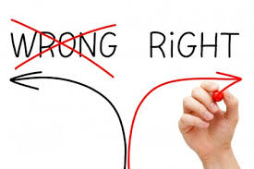
Summary: Ethics concerns all levels of life
There are many ways to think about right and wrong or good and bad actions.

Slide 7
Difference between Ethics and Morality ?
Certain customs or behaviours are recognised as good and others as bad. With modern society’s many cultures and traditions however there is no single easily identified truth.
Morality is an assessment of what is good, bad, right, wrong or just for all.
Ethics is an individual assessment of values as being good or bad and is restricted to one’s own individual worldview.

Slide 8
“How should I act?” and “What should I do?” are ethical questions.
“How should we live together?” Is a moral question.
There is a difference between what I should do in an ethical dilemma, and what we should do in a moral dilemma.
Ethics, Morality and Law all deal with questions on how we should live together.

Slide 9
Choice of Behaviour and the Law
Choices of behaviour are also made using religion, law, tossing a coin.
Religions may advocate dietary restrictions or dictate sexual behaviors.
Laws and Governments should be ethical, but the law establishes precedent in trying to cover universal, not individual guidelines.
Law can also be slow to address new problems.

Slide 10
LAW | ETHICS | MORALS
Creates and enforces rules about how individuals relate to each other and to the State. | Unwritten principles | Create rules for the molding of character within individuals.
Interpreted by the courts. | Interpreted by each individual | Interpreted by Society
Concerned with conduct of individuals as measured against a standard | Presented by philosophers, religious and professional groups. | Concerned with motive and being good within themselves.
Apply to everyone and aims to help society function smoothly. | Personal choice. Priority determined by each individual. | Matter of individual conscience
Has relative value and varies with time and between societies. | Has personal value. | Morals are considered to have universal value and apply to everyone.
Enforced by military, police and courts | Personal control over sense of what is right and wrong. | Limited enforcement, peer group and cultural pressures.

Slide 11
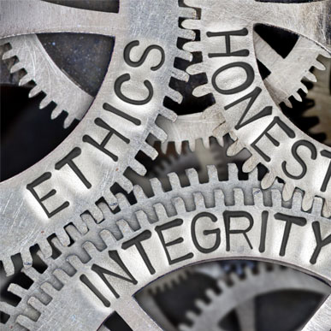
What is the Difference Between Unethical and Illegal Business Practices?
'Unethical' is morally wrong, whilst being 'illegal' means it is against the law.
In an illegal act, the decision-making factor is the law.
For an unethical act, the deciding agent is personal conscience.
An unethical deed may be immoral but not against the law.
An illegal deed is always unethical while an unethical deed may or may not be illegal.

Slide 12
Understanding unethical business practices
Unethical behaviour is failing to do the right thing.
In the workplace such as :-
Any deeds that violate the law such as theft or violence,
Deliberate violations of company policies.
Using hard-sell sales practices.
These final two actions are legal, but they take advantage of human frailties for personal advantage and go against the ethics of a lot of people.
Further Examples of unethical behaviour are:-

Slide 13
Deliberate deception :-
Taking the credit of someone else's work,
‘Pulling a sicky',
Sabotaging the work of someone else.
Misrepresenting a product all with the aim of getting a sale.
These actions are unethical as they exploit the trust of others.
Violation of conscience :– If your boss forces you to do something you know is wrong, the boss is showing unethical behaviour, and causing you to violate your conscience.
Failure to honour commitments :– If your boss goes back on a promise, they have acted unethically. This results in a loss of trust and respect, potentially leading to a workforce filled with discontent.

Slide 14
Understanding illegal business practices
Illegal business practices are much more obvious.
If it is against the law, it is illegal and unethical.
Should therefore lead to serious consequences such as prison and heavy fines.
https://www.delta-net.com/compliance/ethics/faqs/what-is-the-difference-between-unethical-and-illegal-business-practices
Further examples of illegal business practices are:

Slide 15
Discrimination or Harassment – Can be based on age, gender, sexual orientation, race , etc. Unfair discrimination is breaking the law.
Theft – If your business is stealing, they are breaking the law.
Employee Treatment –failure to pay employees the correct way. This can refer to meeting minimum wage, maternity leave, redundancy, and pensions.
Environmental – An example of this was Northumbrian Water being fined £375,000 for pumping raw sewage into the River Tyne.
Health and Safety –Failure to supply workers with information and guidance on health and safety policies leads to fines, or prison.

Slide 16
Who needs to obey the law ? Do laws apply equally to everyone ?

Slide 17
Example 1 Politicians and judges to be included in Sex Discrimination Act, federal government announces
At present, legislators, judges and public servants are exempt from complaints about workplace gender discrimination, as are some employers of volunteers, because of a legal loophole that means they are technically not the complainant’s employer.
The report into sex discrimination in Australian workplaces found that one in three people experienced sexual harassment.
Action triggered by former Liberal staffer Brittany Higgins's allegation that she was raped in a ministerial office in 2019.
High Court also revealed an independent investigation found six former associates were sexually harassed by former Justice Dyson Heydon.

Slide 18
Changes to the Fair Work Act and the Sex Discrimination Act as follows:
MPs, judges and state public servants will be liable for and protected from sexual harassment in their workplace.
Sexual harassment is a valid reason for dismissal
“Serious misconduct" in the Fair Work Act to include sexual harassment
A “stop bullying order” to be available in the context of sexual harassment
Mr Morrison said this was about getting everyone on a level playing field.
Triggered by former Liberal staffer Brittany Higgins's allegation that she was raped in a ministerial office in 2019.
High Court also revealed an independent investigation found six former associates were sexually harassed by former Justice Dyson Heydon.

Slide 19
Example 2 of exemptions to the law
Raytheon Pty Ltd; and BAE Systems Australia Limited
Defence companies around Australia have been granted exemptions to anti-discrimination laws, when they contract with the United States not to transfer controlled material to nationals of certain proscribed countries, which currently includes countries such as China, Vietnam, Lebanon and Sri Lanka. The restriction is based solely on place of birth, and applies to dual nationals who are also Australian citizens.
Details are available on the ACT Legislative Register.

Slide 20
Ethical and Moral discussion slides

Slide 21
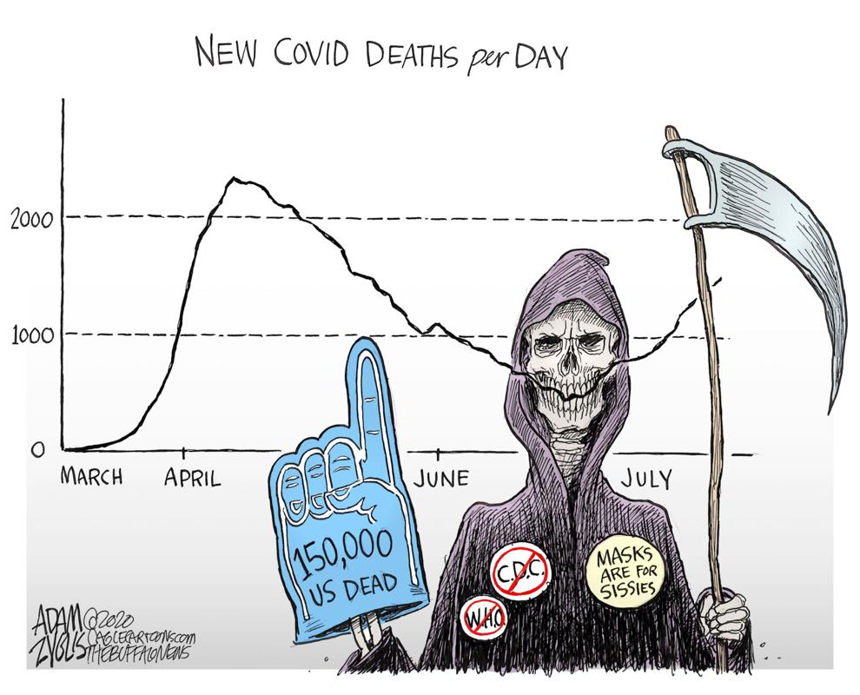
1 Ethical issues raised ?
July 30, 2020: 150,000 deaths
by Adam Zyglis, The Buffalo News

Slide 22
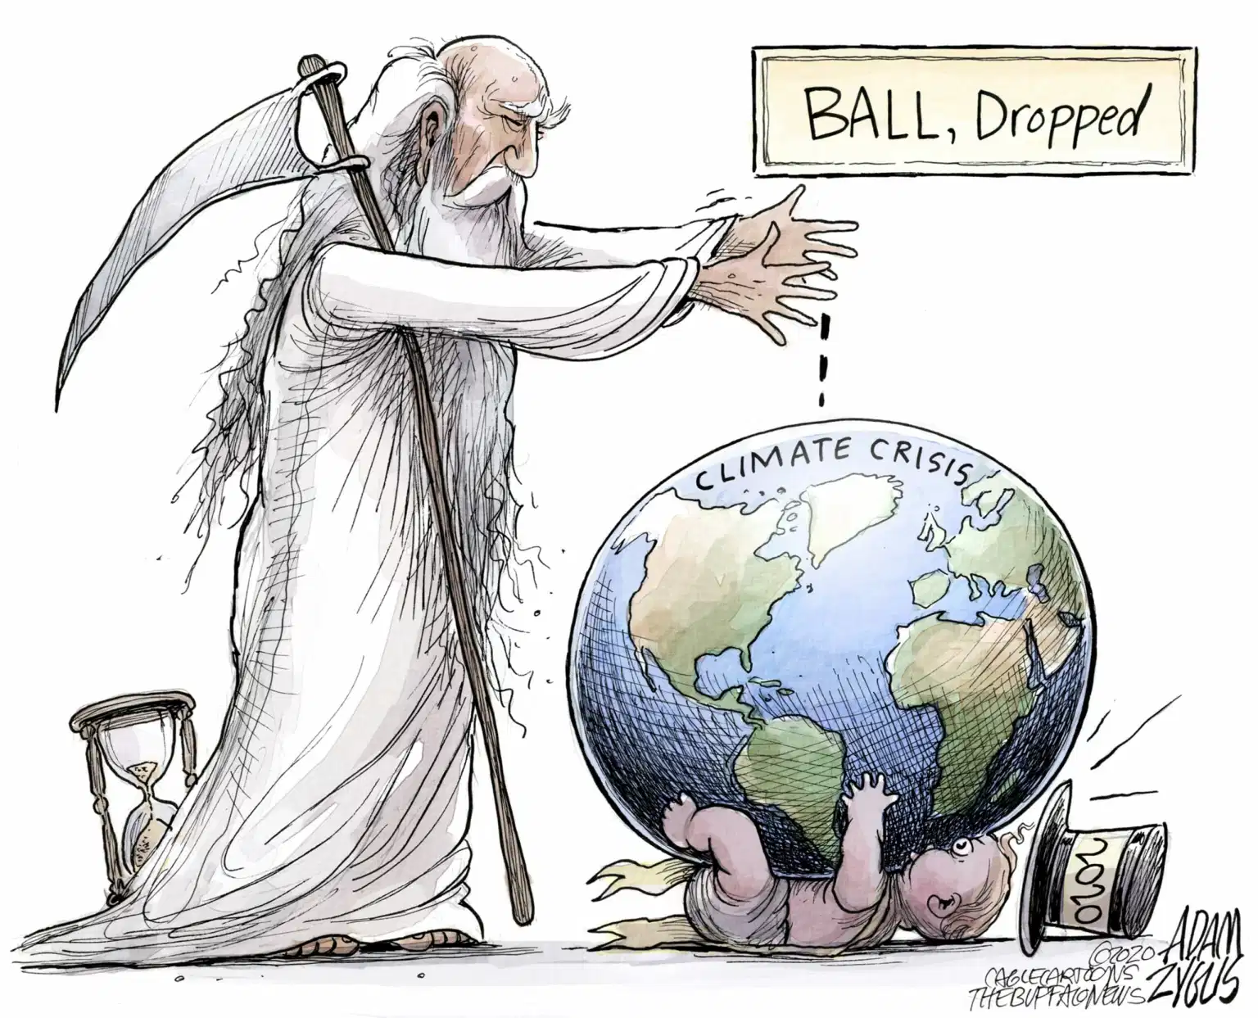
2 Ethical issues raised ?
New year, same crisis: January 1, 2020

Slide 23
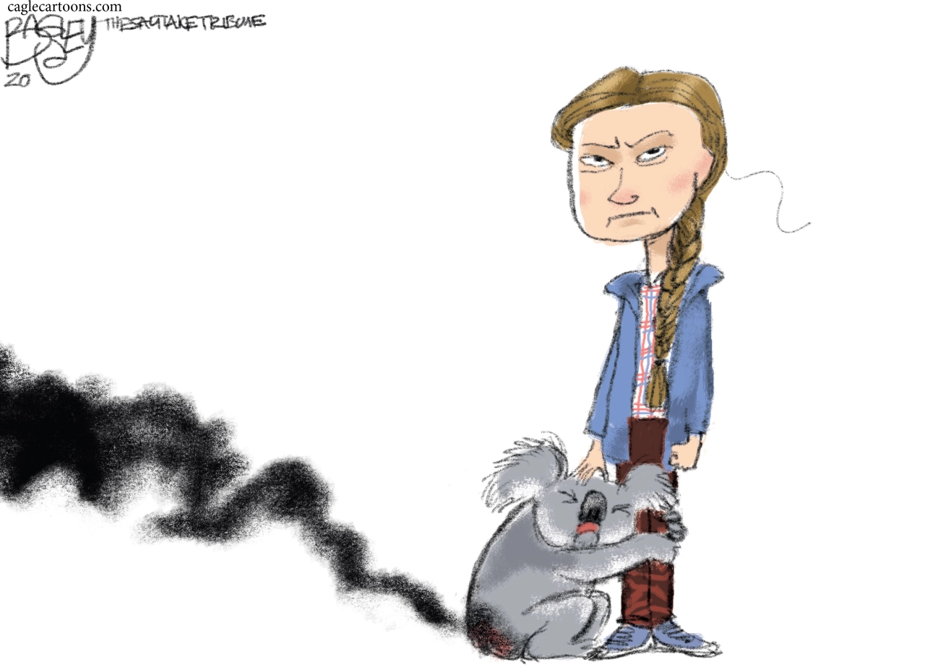
3 Ethical issues raised ?
At least 24 people have died, about half a billion animals have been killed and nearly 400 homes have been destroyed

Slide 24
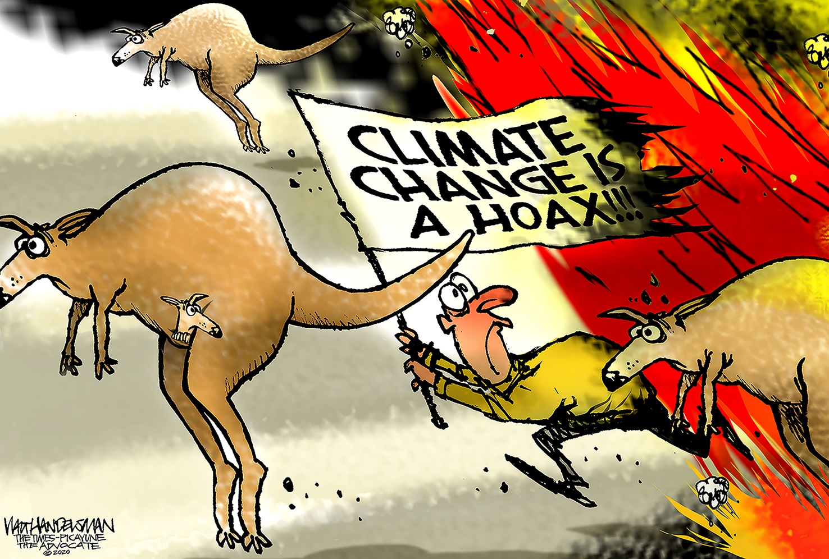
4 Ethical issues raised ?

Slide 25
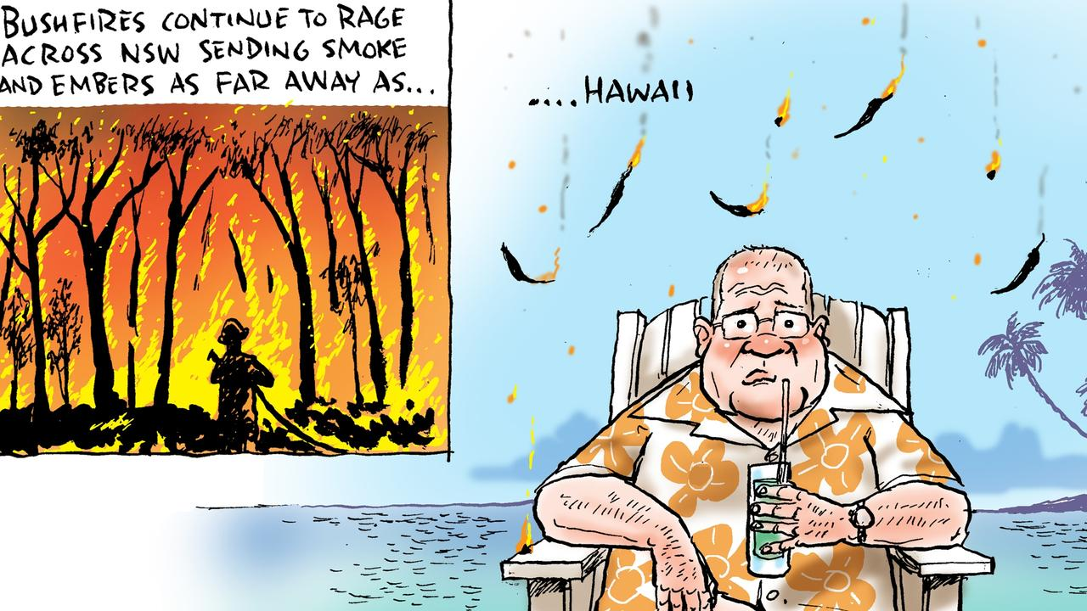
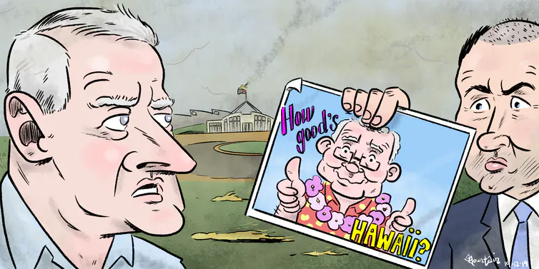
5 Ethical issues raised ?
PM goes off secretly to Hawaii on a holiday with his family whilst bush fires rage in NSW

Slide 26
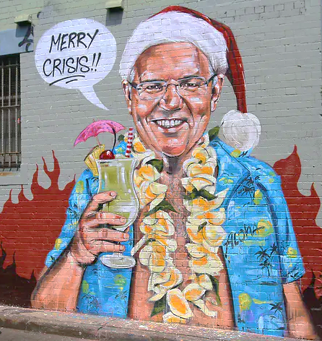
6 Ethical issues raised ?
As the fire season ramped up in November last year, New South Wales Nationals leader John Barilaro accused the Greens of preventing governments from conducting hazard reduction burning, implying the party should shoulder blame for the fires.
“We’ve got to do better and I know that we don’t do enough hazard reduction because of the ideological position from the Greens,” he said.

Slide 27
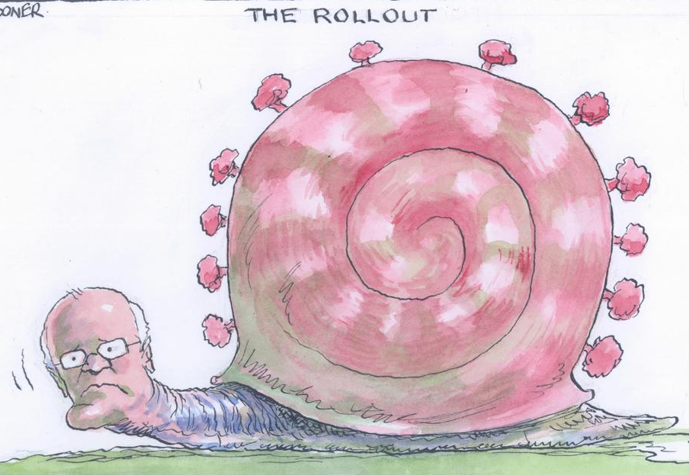
7 Ethical issues raised ?

Slide 28
ASUS
Example: Company Code of Conduct and Compliance procedures

Slide 29
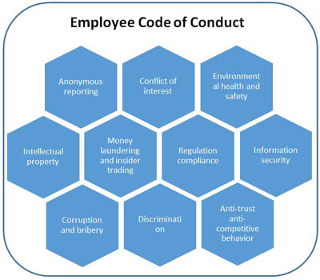
ASUS engages in all business activities with honesty and forbids corruption and fraud.
A system of rewards and punishments ensures employees
do not accept demands, contract, bribery, or any other improper benefits.
A violation of the Employee
Code of Conduct can be
reported through a public
Mailbox. ASUS will provide protection for whistle blowers from unfair and disrespectful treatment.

Slide 30
Bribery and Anti-Corruption Principle:
ASUS employees must not bribe public officials and must never engage in or facilitate corrupt practices in any pattern.
ASUS employees must not contribute to illegal political donations, improper charitable donations, or improper sponsorship.
It is ASUS’ policy to cease engagement with those agents or contractors who are likely to bribe when dealing with ASUS’ affairs on behalf of ASUS.
Giving a gift or entertainment, to public officials on behalf of ASUS shall be subject to Legal Affairs review.
In case of a violation of the Employee Code of Conduct, the employee will receive a penalty according to case scenarios and regulations.
ASUS severely punishes incidents where regulations are violated, and the case will be reported to judicial units for investigation.

Slide 31
Workplace Violence and Sexual Harassment Prevention
Management Standard
ASUS formulates Illegitimate Invasion and Workplace Violence Management Standard(F2-047) and Sexual Harassment Prevention Management Standard (F2-031).
In the event of illegitimate invasion, an employee could file a consultation and complaint through workplace violence and sexual harassment prevention hotline: 6666@asus.com.
The Company will immediately start the investigation and processing mechanism upon receiving such complaints filed by the employee.
The workplace violence and sexual harassment prevention hotline: 6666@asus.com is a confidential and private reporting channel.

